Slide 1











DESIGN PRINCIPLES
Santiago Cano

Slide 2
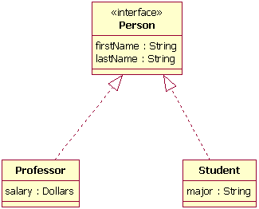
Object oriented programming (OOP)
Interface: Structure to declare properties and functions without behavior code.
Inheritance: This technique allows easy re-use of the same procedures and data definitions, in addition to potentially mirroring real-world relationships in an intuitive way.
Notes:
The first example can be the human being, then explain with DB and the CRUD.
Inheritance = Herencia.
UML: Unified Modeling Language

Slide 3
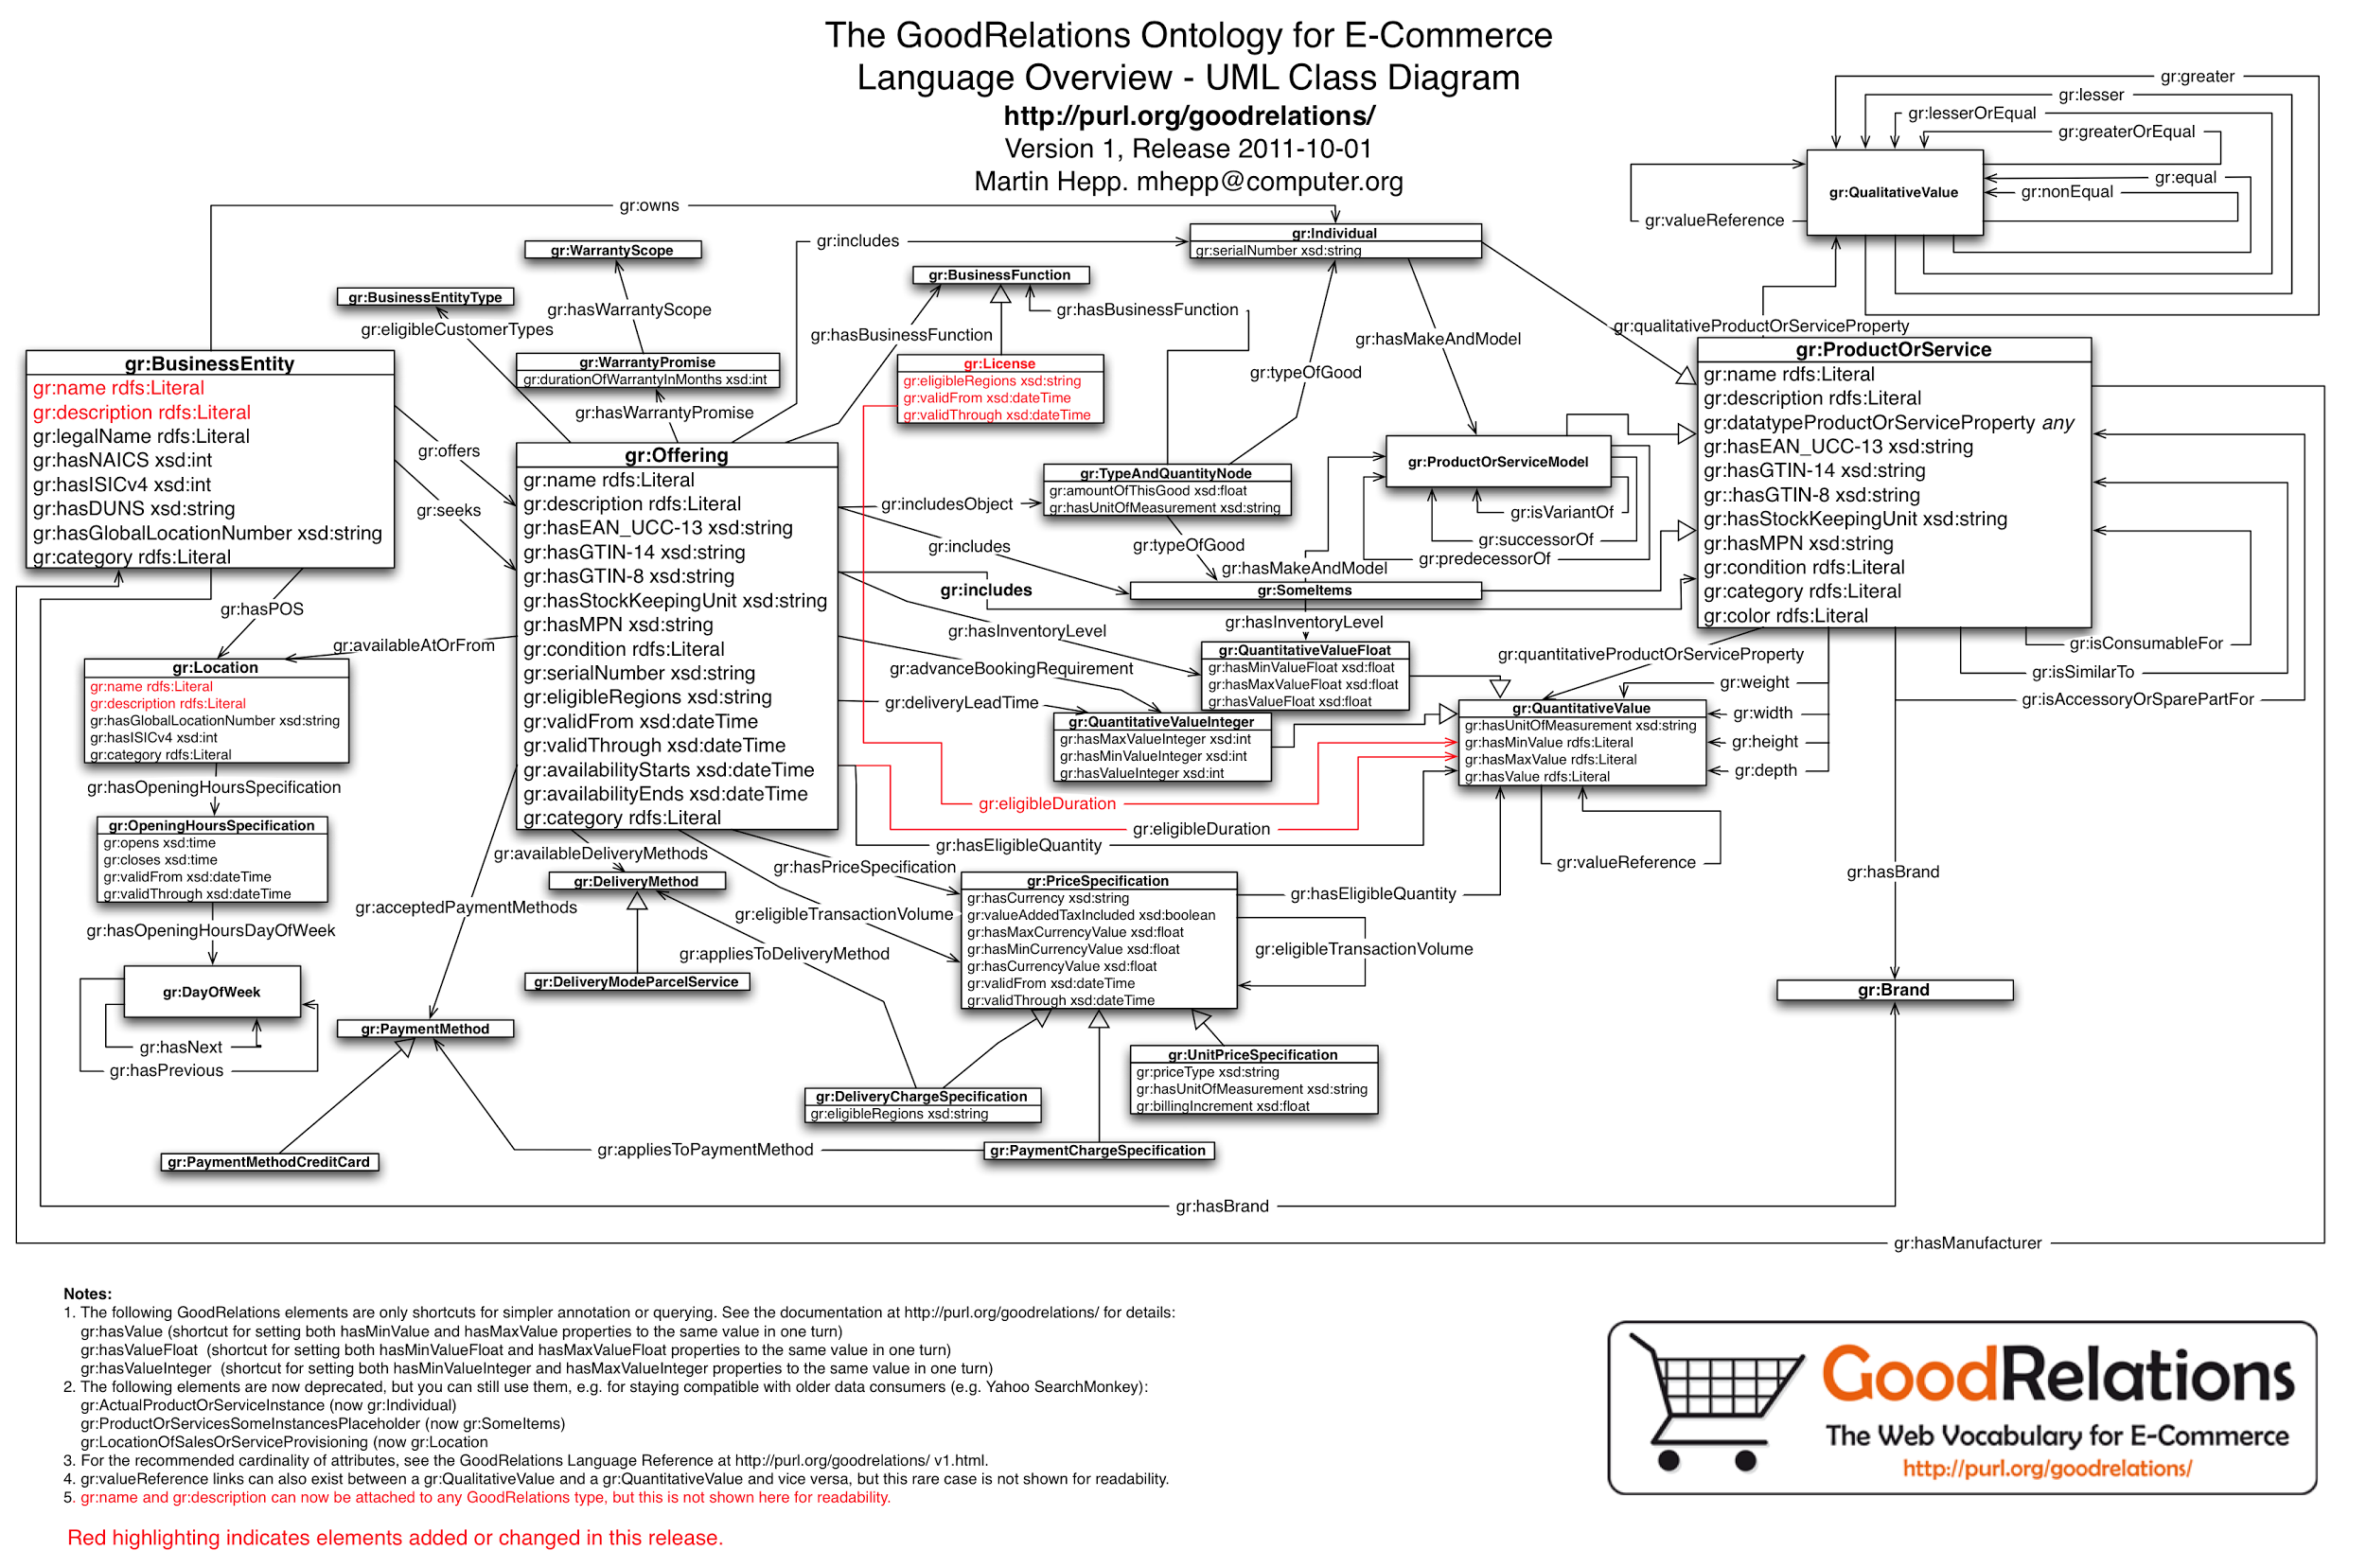
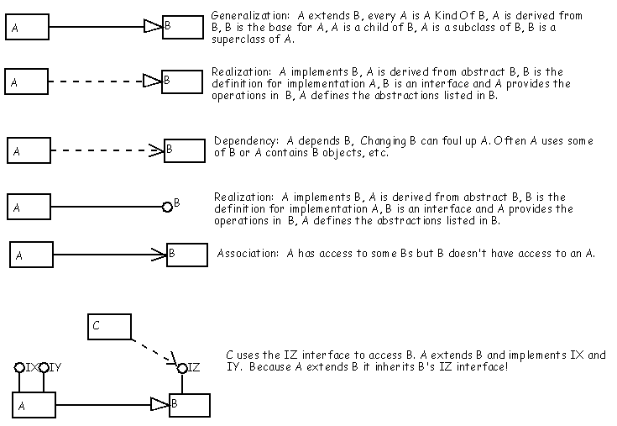
Object oriented programming (OOP)

Slide 4
Object oriented programming (OOP)
Interface: Structure to declare properties and functions without behavior code.
Inheritance: This technique allows easy re-use of the same procedures and data definitions, in addition to potentially mirroring real-world relationships in an intuitive way.
Polymorphism: Allow different behavior in the same interface depending of what class it implements.
Abstraction: Aims to reduce duplication of code duplication.
Encapsulation: Concept to manipulate data and functions that keeps both safe from outside interference and misuse.
Notes:
Abstraction: move duplicate code to a common class

Slide 5
Access Modifier | Detail
public | Access is not restricted
protected | Access is limited to the containing class or types derived from the containing class
internal | Access is limited to the current assembly
protected internal | Access is limited to the current assembly or types derived from the containing class
private | Access is limited to the containing type
private protected | Access is limited to the containing class or types derived from the containing class within the current assembly
Notes:
Protected example:
class A { protected int x = 123; } class B : A { static void Main() { A a = new A(); B b = new B(); // Error CS1540, because x can only be accessed by // classes derived from A. // a.x = 10; // OK, because this class derives from A. b.x = 10; } }

Slide 6
Generics
Generics is not generic collections
Generic classes
Generic interfaces
Generic Type Parameters
Generic methods
Generic delegates
Notes:
Generics were added to version 2.0 of the C# language
Most common are ICollections, IList…
https://docs.microsoft.com/en-us/dotnet/csharp/programming-guide/generics/generic-classes
https://docs.microsoft.com/en-us/dotnet/csharp/programming-guide/generics/generic-interfaces
https://docs.microsoft.com/en-us/dotnet/csharp/programming-guide/generics/generic-methods
https://docs.microsoft.com/en-us/dotnet/csharp/programming-guide/generics/generic-delegates

Slide 7
What are generics?
Classes, structures, interfaces and methods that have placeholders (type parameter) for one or more of the types that they store or use.
Example:
Definition: List<T>
Defines a collection (List) with a type parameter (T).
T can represent any type (class, struct, interface).
Usage: List<string>
Declares that the collection (List) will operate on type string.
List insert methods will prevent non-strings from being added.
List retrieval methods will return string objects.
Notes:
Placeholder: referente
Generics were added to version 2.0 of the C# language
Most common are ICollections, IList…
https://docs.microsoft.com/en-us/dotnet/csharp/programming-guide/generics/generic-classes
https://docs.microsoft.com/en-us/dotnet/csharp/programming-guide/generics/generic-interfaces
https://docs.microsoft.com/en-us/dotnet/csharp/programming-guide/generics/generic-methods
https://docs.microsoft.com/en-us/dotnet/csharp/programming-guide/generics/generic-delegates

Slide 8
Benefits
Type Safety: Generics enforce compile-time type checking and eliminate the need for casting “object” to a more specific type.
Performance : Generics prevent boxing / unboxing when using value types.
Flexibility / Reuse: Generics allow us to use a single class, interface, or method with a variety of parameter and/or return types..
Notes:
Boxing is the process of converting a value type to the type object or to any interface type implemented by this value type. When the CLR boxes a value type, it wraps the value inside a System.Object and stores it on the managed heap. Unboxing extracts the value type from the object. Boxing is implicit; unboxing is explicit. The concept of boxing and unboxing underlies the C# unified view of the type system in which a value of any type can be treated as an object.

Slide 9
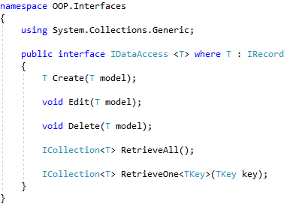
Look at the code
Generic types can use multiple type parameters and constraints

Slide 10
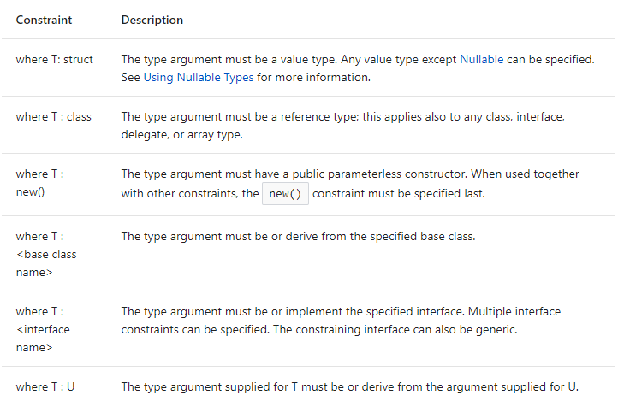
Constraints
Notes:
The struct type is suitable for representing lightweight objects, like small classes
https://docs.microsoft.com/en-us/dotnet/csharp/programming-guide/nullable-types/using-nullable-types

Slide 11
Key Design Principles
Separation of concerns: Divide your application into distinct features with as little overlap in functionality as possible.
Single Responsibility principle: Each component or module should be responsible for only a specific feature or functionality. First of SOLID Principles.
Principle of Least Knowledge: A component or object should not know about internal details of other components.
Don’t repeat yourself (DRY): The functionality should not be duplicated in any component.
Minimize upfront design: Only design what is necessary, also know as YAGNI (You ain’t gonna need it). Keep it simple!
General responsibility assignment software patterns (GRASP): consist of guidelines for assigning responsibility to classes and objects in object-oriented design.
Notes:
Concern: preocupación, interés.
Least: minimo.
Upfront: por adelantado.
Guidelines: pautas generales.
GRASP: High cohesion and low coupling
High cohesion is about making sure module doesn't do many things, it is meant to do only one particular thing
Low Cohesion is not depend on each other

Slide 12
What are SOLID principles?
Set of practices that, when implemented together, make code adaptive to change. The SOLID practices were introduced by Bob Martin almost 15 years ago. It is the acronym of:
Single responsibility.
Open/closed.
Liskov substitution.
Interface segregation.
Dependency injection.
Notes:
Acrónimo de un conjunto de prácticas

Slide 13
Why use them?
Short and simple code.
Readable and extensible.
Adaptative code.

Slide 14
SOLID: The single responsibility principle
It is the lynchpin of adaptative code.
Write code that has one and only one reason to change.
Notes:
lynchpin: eje

Slide 15
SOLID: The open/closed principle
Open for extension: The behavior can be extended. We are able to change what the method does.
Closed for modification: The signature of the method and his response remains untouched.
Notes:
Data access object

Slide 16
SOLID: The Liskov substitution principle
A could be replaced by B without modify the behavior
Notes:
Don't forget to explain change classes (A can be changed by B without break nothing) Contracts: https://msdn.microsoft.com/en-us/library/system.diagnostics.contracts.contract(v=vs.110).aspx
Warning Invariance
Invariant: is a set of assertions that must always hold true during the life of an object for the program to be valid. It should hold true from the end of the constructor to the start of the destructor whenever the object is not currently executing a method that changes its state.

Slide 17
SOLID: The Liskov substitution principle
Collection of guidelines for creating inheritance hierarchies in which a client can reliably use any class or subclass without compromising the expected behavior.
Contract rules:
Preconditions cannot be strengthened in a subtype.
Postconditions cannot be weakened in a subtype.
Invariants of the supertype must be preserved in a subtype.
Variance rules:
There must be contravariance of the method arguments in the subtype.
There must be covariance of the return type in the subtype.
No new exceptions can be thrown by the subtype unless they are part of the existing exception hierarchy.
Notes:
Contracts: https://msdn.microsoft.com/en-us/library/system.diagnostics.contracts.contract(v=vs.110).aspx
Warning Invariance
Invariant: is a set of assertions that must always hold true during the life of an object for the program to be valid. It should hold true from the end of the constructor to the start of the destructor whenever the object is not currently executing a method that changes its state.

Slide 18
SOLID: Interface segregation
Interfaces should be small.
Interfaces should contain single methods that serve a single purpose (Granularity).

Slide 19
SOLID: Dependency injection
Technique whereby one object supplies the dependencies of another object.
It is one form of the broader technique IoC.
Three types of dependency injection:
Constructor injection: the dependencies are provided through a class constructor.
Setter injection: the client exposes a setter method that the injector uses to inject the dependency.
Method injection: the dependency provides an injector method that will inject the dependency into any client passed to it. Clients must implement an interface that exposes a setter method that accepts the dependency.
Notes:
Poor man dependency injection
IoC

Slide 20
When and where to apply?
Deciding when and where to apply any pattern or practice is part of the art of software development.
Overuse leads to code that is adaptive, but on too fine-grained a lever to be appreciated or useful. Overuse also affects another key facet of code quality: readability.

Slide 21
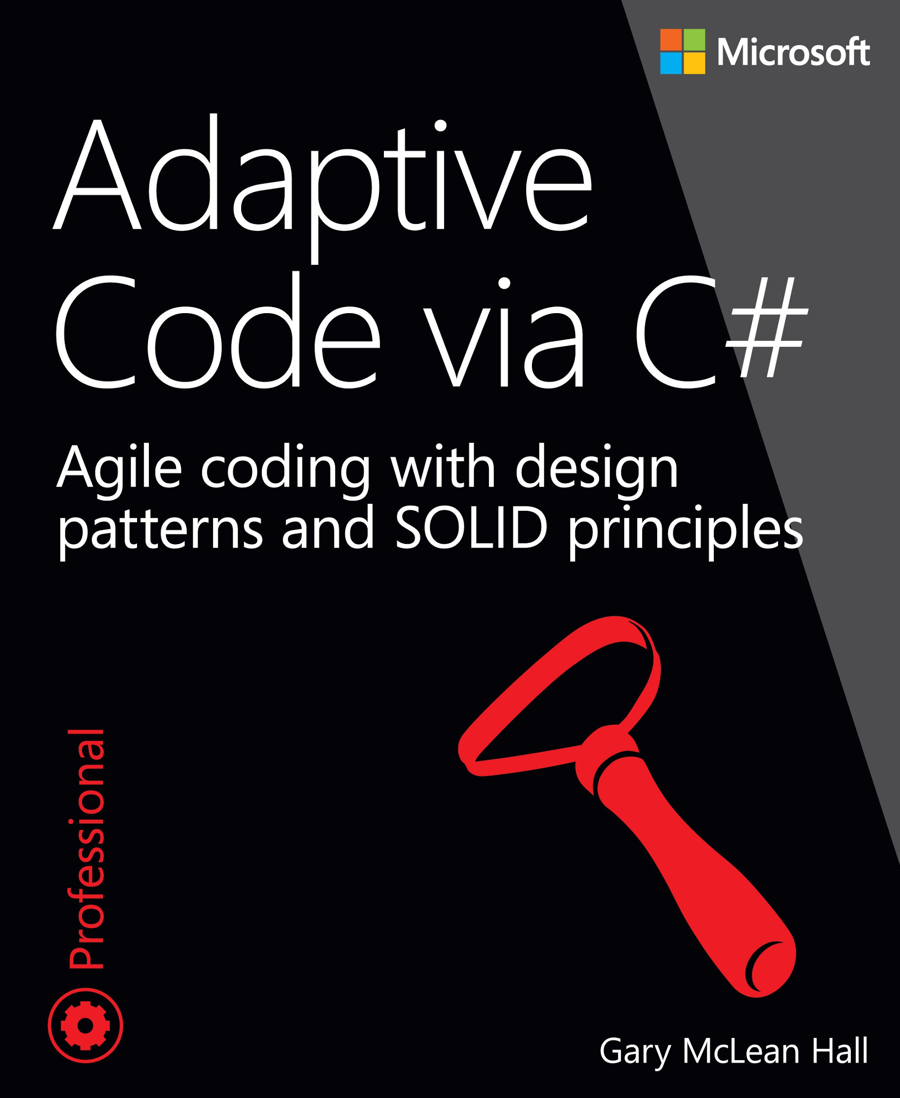

Slide 22
Thanks!
Notes:
Split CRUD

